Slide 1
Data Center References
Kehua Tech：Johnson

Slide 2
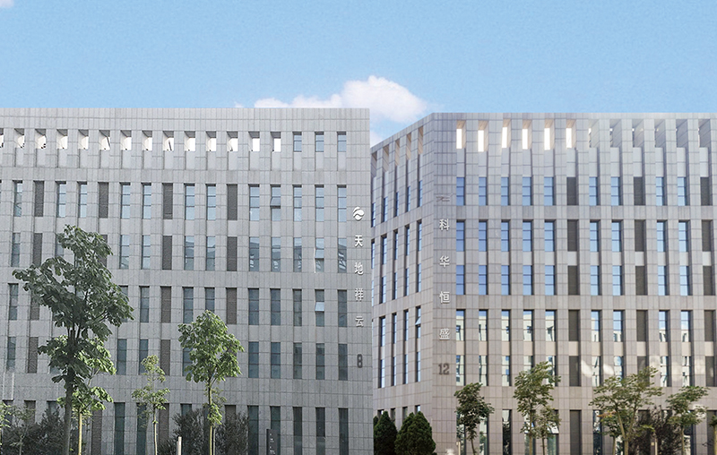

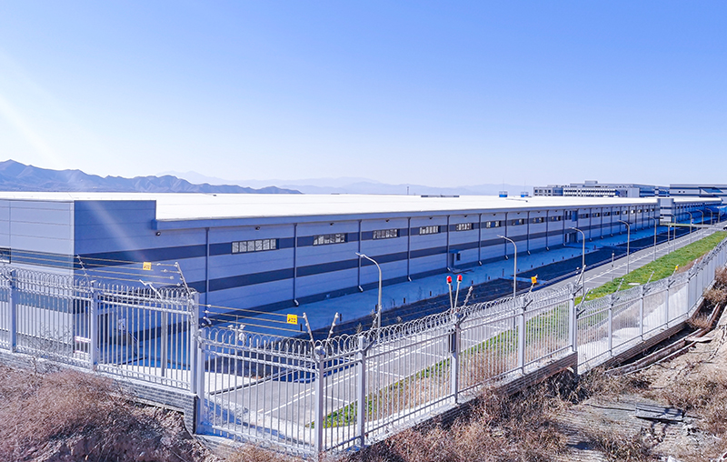
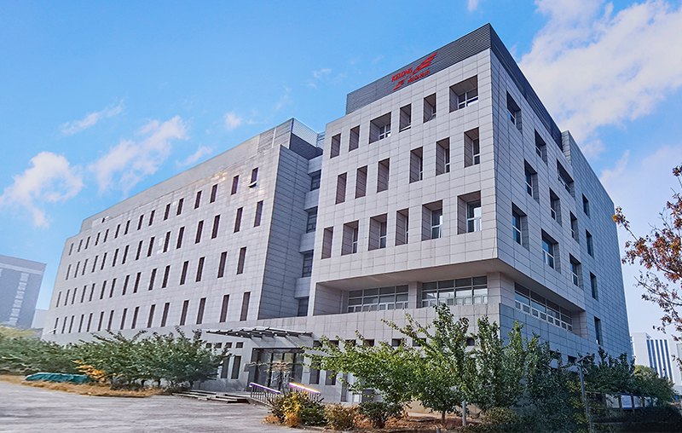
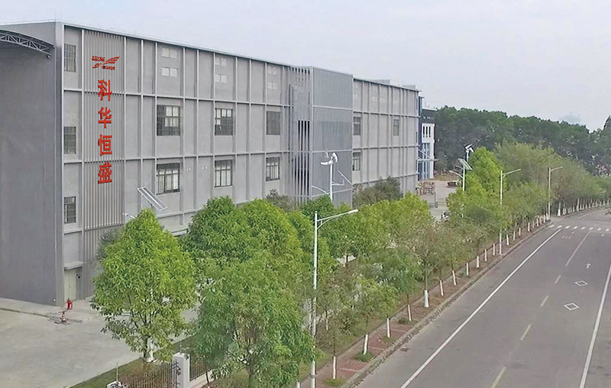
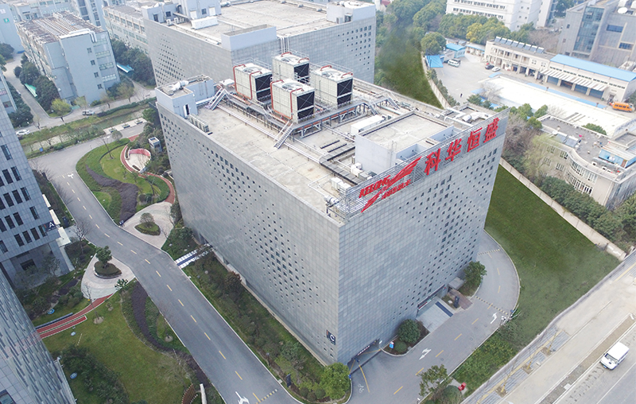
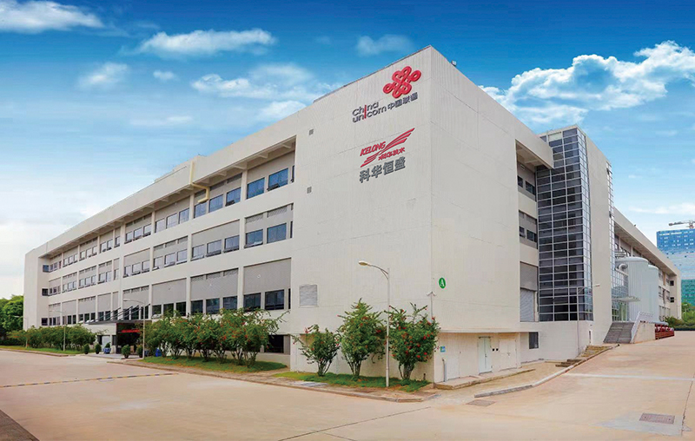
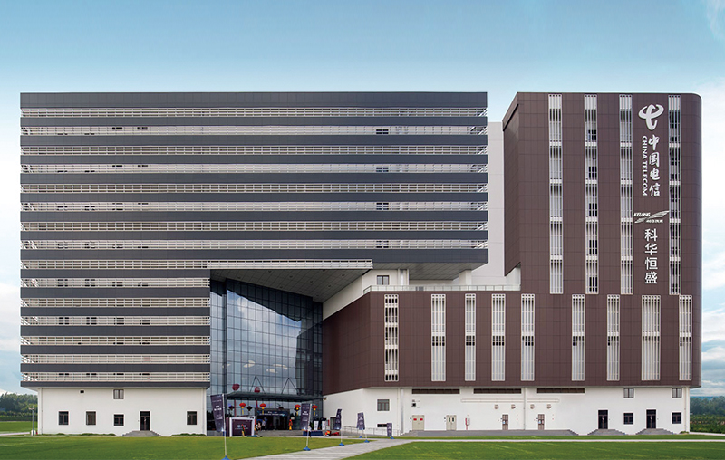
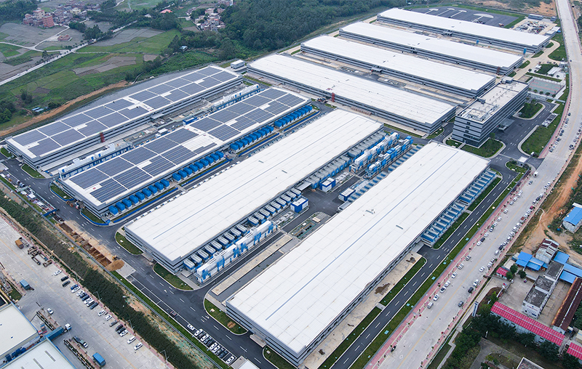
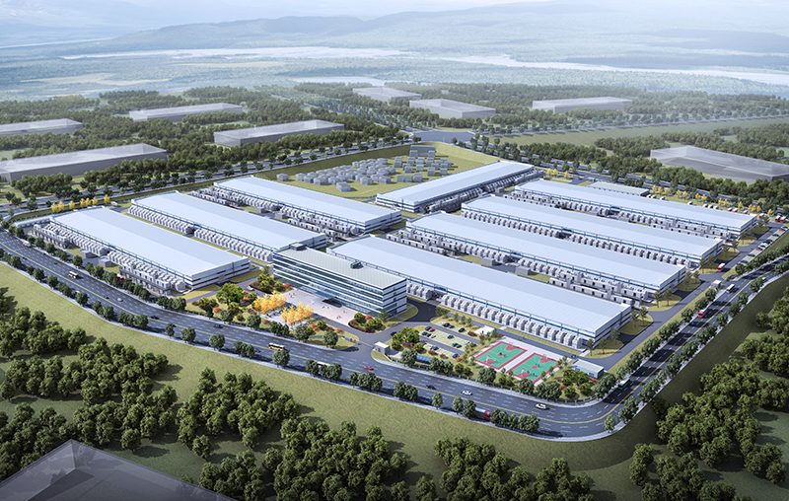
Project Reference-Kehua 9 Self-owned Data Center
As a third-party neutral cloud infrastructure and cloud service provider, Kahua Data has over 10 years of experience in data center construction and operation, and has built 9 data centers in Beijing, Shanghai, Guangzhou and surrounding cities
Beijing KeZhong Data Center
Zhangjiakou Tengzhi Data Center
Beijing Zhongteng Data Center
Guangzhou Keyun Data Center
Shanghai KeZhong Data Center
Guangzhou Qian Sheng Data Center
Qingyuan Guoteng Data Center
Qingyuan Ruiteng Data Center
Guangzhou Desheng Data Center
Notes:
1、自建数据中心介绍：
1、自建数据中心的原因：深入了解应用场景和应用需求
2、主要使用业主：电信运营商、政府、互联网运营商；

Slide 3
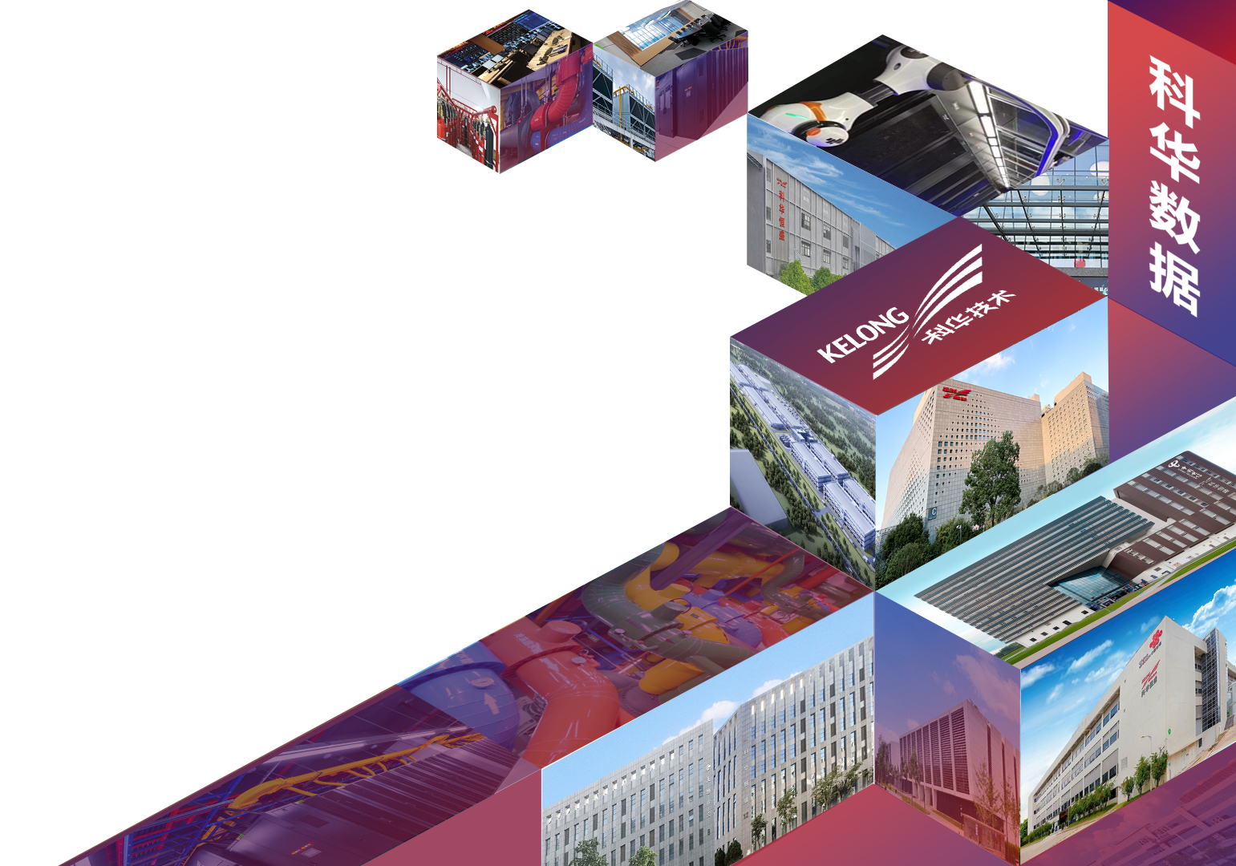


北京科众数据中心
Kehua・KeZhong DataCenter
科华数据股份有限公司

Slide 4
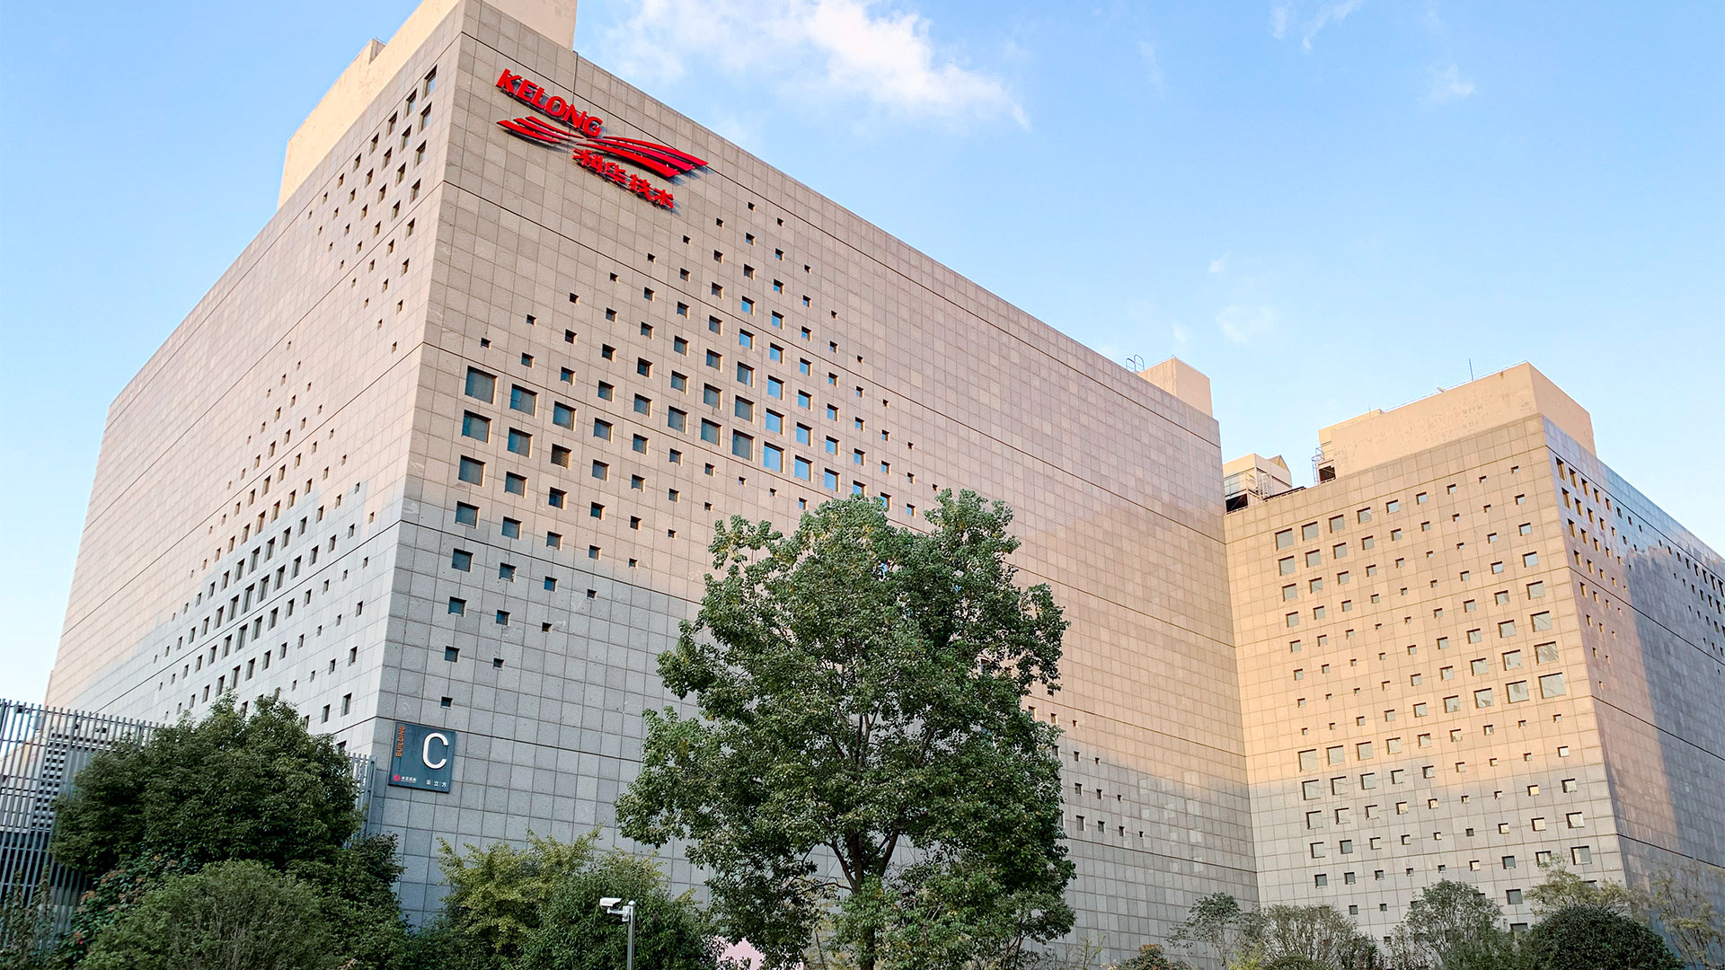




Self-build
ISO Certificate
I&S Certificate level 3
A Tier Data center certificate

Slide 5






Kehua・Design Concept of Data center
Standardization
Modularization
Intelligence
GB50174-2017
TIA-942
Modular design
reduce TCO
Intelligent control
Energy management
Flexibility
Reliability
Green power
Capacity upgrade dynamically
Capacity expand dynamically
SLA Network 99.9%
SLA Utility 99.99%
High efficiency
Low PUE
Low carbon

Slide 6






Kehua・Advantages of Data center
High availability
High Agility
High Power
Follow top tier standard to meet redundancy
Deliver as module form or
customized form
Sufficient power capacity to meet 3-10kW/rack requirement
Network resource
Customers
Management service
Venue resources can be customized for enterprise customers and Internet customers
Various operators connect in，High quality BGP bandwidth resource,linkage with other public cloud platform
High-quality operation and maintenance management services, one-stop data center service delivery

Slide 7
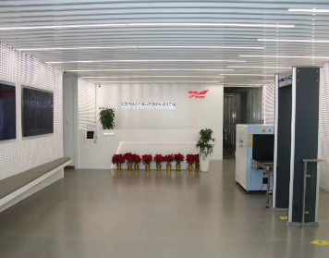
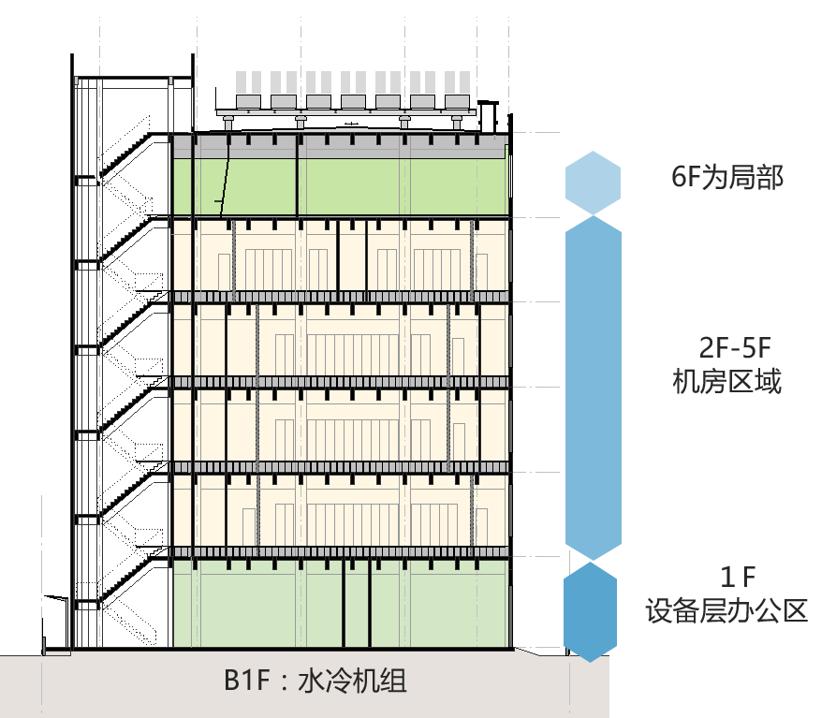





Overview of KeZhong
Type：Self-build
Level：Tier 3+
Rack quantity：3,780 pcs
Building height：36.2m
Area square meter：
21,000㎡，2~5 floor per 3,843㎡
Seismic level：7 tier
Load-bearing：1,000kg/㎡
Elevator ：2 for cargo,2 for guest
6 floors
10kN/m²
6m room height
Tier 3+
Notes:
1\first floor put GE/water cooling equipments
2、2~5 is IT room
3、top floor put condenser

Slide 8




Data center Location
About 50 minutes drive from Pudong International Airport
About 30 minutes drive from Hongqiao Airport (Railway Station).
Convergence of Metro 1 and 7, with direct access to Metro 1 from the above ground access road.
8 five-star hotels, restaurants and fitness clubs within a 3-kilometer radius
25 bus lines consist a three-dimensional transportation network, convenient access to the whole city.
Kezhong
Data center
5KM
16 KM
8 KM
Metro4
Shanghai train station
Bus
station
8 KM
39 KM
Metro2
People’s
square
Metro7
HongQiao
airport
Metro1
Oriental pearl
tower
Pudong
airport

Slide 9
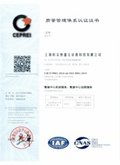
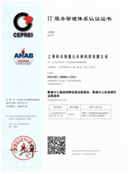
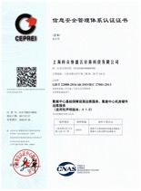

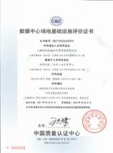
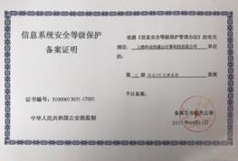
Data center certificate
ISO 9001
ISO 20000
ISO 27001
、
ISO 14001
ISO 22301
A tier datacenter certificate
I&S 3Tier

Slide 10

High availability data center
Description | A Tier | T3+ Tier
UPS redundancy | 2N or（N＋1） M＝2、3、4… | 2N
Battery | 15min | ＞30min
Transformer redundancy | M（1+1） （M=1、2、3……） | 2N
Separate functional area | Comply | Comply
Maintenance online | Comply | Comply
Fault tolerance | Comply | Comply
Critical load | ＜90% | ＜90%
Power density（kW/㎡) | -- | 2
Continuous cooling | Comply | Comply
Raised floor rate | 100% | 100%
Raise floor height | ＞400mm | 800-1,100cm
Single point of failure | No shutdown | No shutdown
Fire alarm system | Early stage | Very early stage
Dual mains input
High level
Cooling guarantee
Safety

Slide 11





Specification of Kezhong data center
Power supply
UPS
Building
Dual mains
12,500kVA/pcs
2N
Cross-powering of different floors
Area： 21,000㎡
Data center
Dedicated building
TIER 3+
SLA99.99%
Generator
Cooling
Fire extinguisher
N+1
Support 12 hours
Chilled Tower 3+1
Chiller 4+1
IG541
Piped automatic fire extinguishing system

Slide 12






Redundant power system
T-01
UPS
A-PDC
T-09
35kV
T-10
T-11
Electricity for Inductive load
connector
A line
T-22
B line
35kV
T-21
Electricity for Inductive load
T-20
T-12
UPS
B-PDC

Slide 13
Electricity security
Electricity configuration
Dachang
Transformer substation
Wanrong transformer substation
Capacity ：dual mains，12,500kVA/pcs
Power for IT loads：2N UPS system
Each UPS full load backup time ：>15mins
Each set of UPS：400kVA×3 parallel
Gen Set
2N
G
UPS A
UPS B
PDU A
PDU B
Racks

Slide 14


UPS system：double fault tolerance design
2N system + crossing power supply
Redundancy of space and system
PDU-A
PDU-B
UPS sys-3F-1
UPS sys-3F-2
PDU-A
PDU-B
UPS sys-2F-1
UPS sys-2F-2

Slide 15
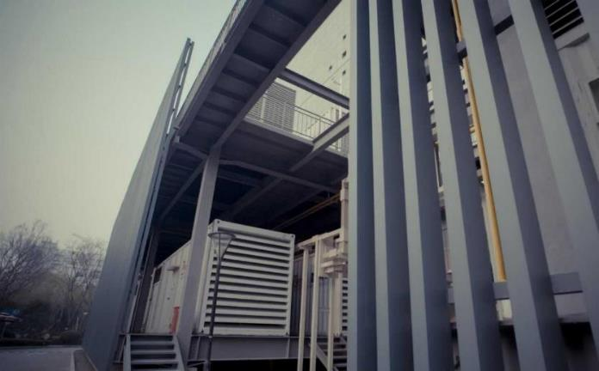

Generator group
发电机 Generator
STAMFORD - P1734D
Germany brand /Automatic Pressure Reduction Adjustment
IP lever：IP22/ Insulation class：H-class
发动机 Engine
MTU - 12V4000G23
MTU (a member of Daimler Benz Group, Germany) electronic injection diesel engine 12V4000G23 was launched in early 1997, is the world's very few diesel engines equipped with electronic monitoring and control management system MDEC, 4000 series is the world's first application of common rail injection system technology of large diesel engines, no overhaul period cycle of up to 30,000 hours.
Generator：N+1
0.4kV
Outdoor diesel ensure 12 hours backup time
1,550kVA（1,240kW）/pcs
Fuel delivery within 2 hours

Slide 16
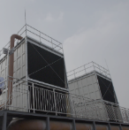
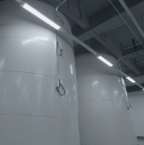


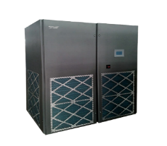
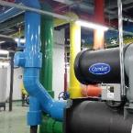
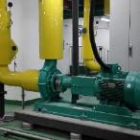
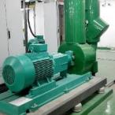
Cooling system
Chilled tower3+1
Refrigerator (tank)
Chiller group
4+1
Internal unit ≥N+1
Cooling water pump
4+1
Chilled water pump 4+1

Slide 17
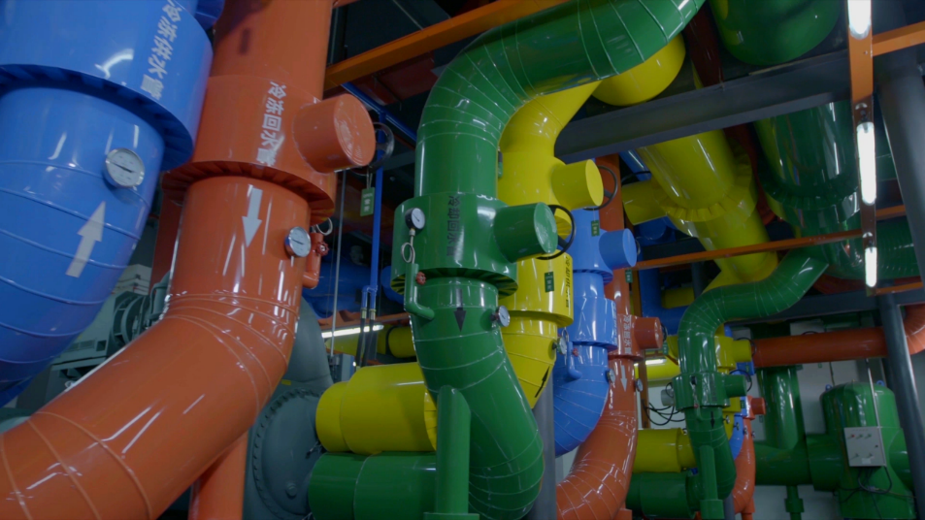
Chiller from Carrier
800 cooling tons each
4+1 redundant design
High efficiency inverter centrifugal chiller

Slide 18
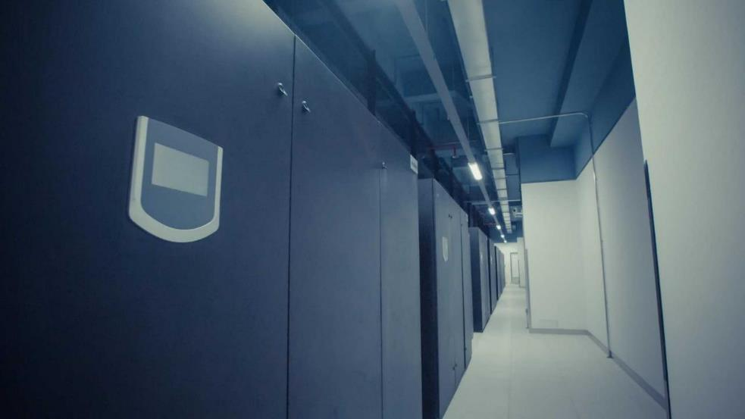
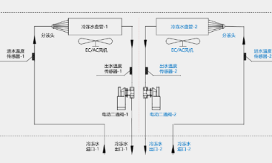
Internal unit-PAC
Chilled water PAC
Dual Coil Design
N+1
Design separate AC room with separate maintenance access
Dual redundancy
Coil+compressor

Slide 19
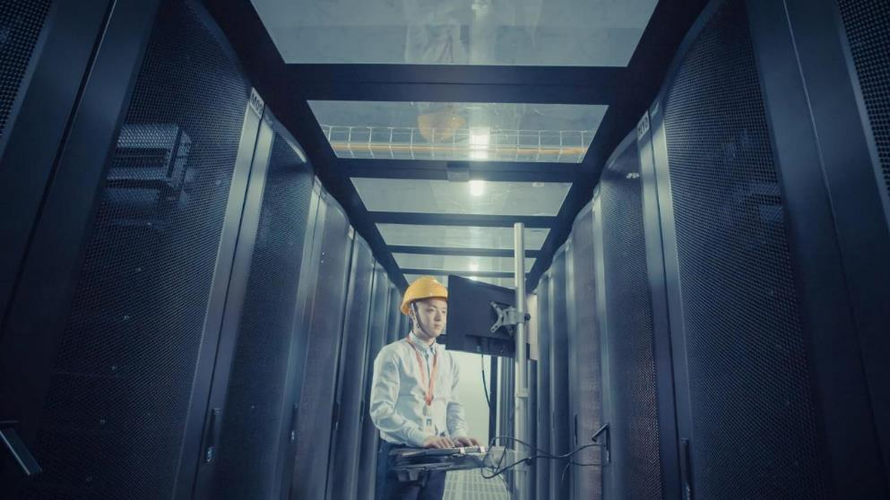
Multiple cooling optimization measures
01
Over 30 Years of Structural Technology from Kehua
Cabinet Cold Aisle Airflow Containment System
02
Air volume adjustable air raise floor
Temperature-sensitive and motor adjust
03
Raised floor in the server room is raised 1 meter
Effectively increase the cooling efficiency
The return air flow temperature is up to 26~28℃ less than traditional DC by 2℃

Slide 20
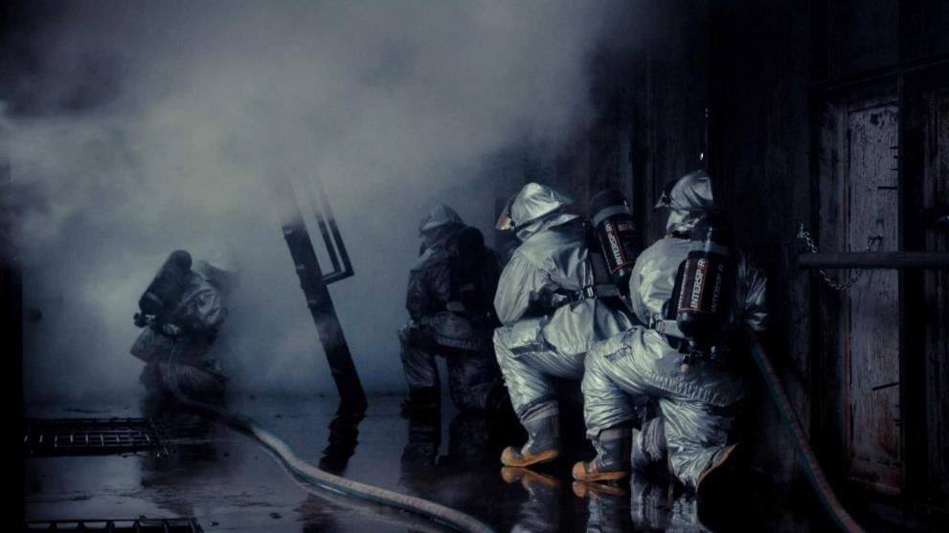

Fire extinguisher system
IG541 adopted in core area, high release pressure and short flooding time
Siemens Automatic Fire extinguisher Mainframe
Water spray adopted in office area，keeping people safe
Very Early Air Sampling Alarm System

Slide 21







Access security
Complete security system
Reservation
Security
Authority
Access
Camera
Area
General area：CCTV
Controlled area：access controlled system，CCTV
Core area： Access control and biometric systems 、CCTV、 anti-theft alarm system 、 Entrance check System 、anti-trailing device
Exclusive customer area ： Customized security management measures

Slide 22
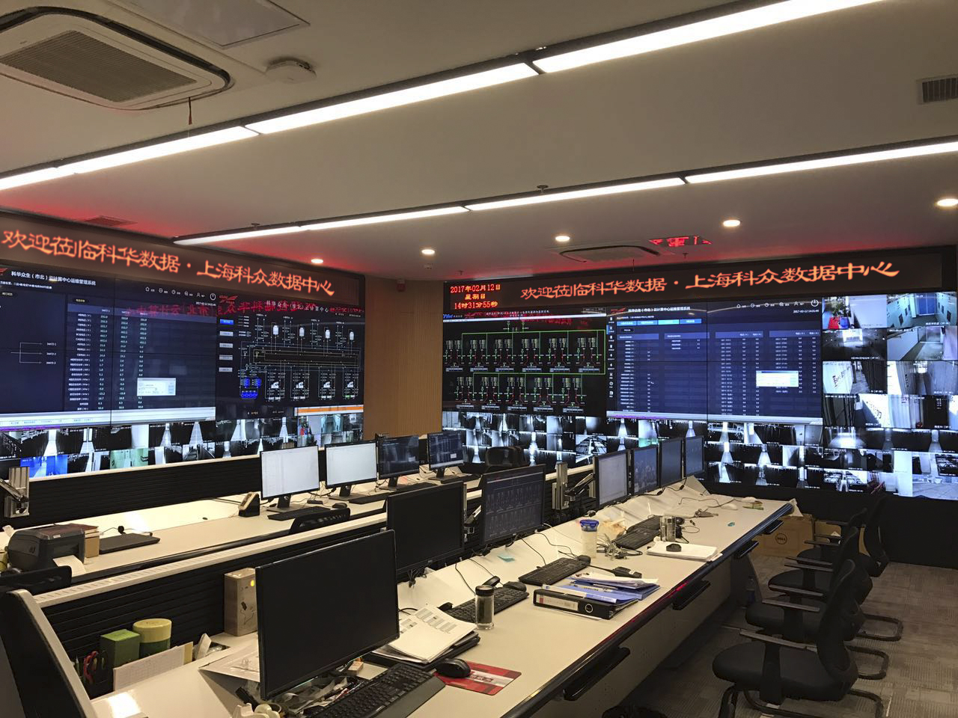
Safe system
7×24 security inspection
7×24 security management
7×24 In and out control
7×24 CCTV
Video stored at least 3 months

Slide 23



THANKS
www.kehua.com
Kehua Data Co., Ltd. Statistics: By the end of 2022
Source：Frost & Sullivan, OMDIA, CCW, FORWARD, CCID, Dun&Bradstreet, etc.

